Slide 1
Polish administration

Slide 2
Polish political system
Government administration
Local administration

Slide 3


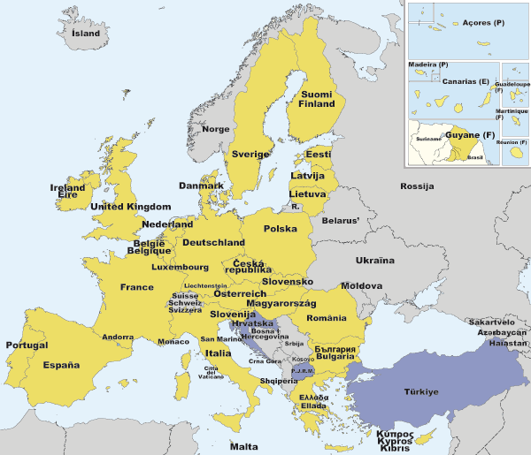
Republic of Poland

Slide 4
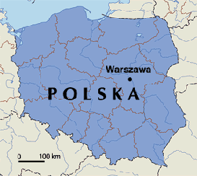

Slide 5
EU accession: 1 May 2004
Area: 312,679 km2
Population (January 2010): 38,163,895*
*http://epp.eurostat.ec.europa.eu/tgm/table.do?tab=table&language=en&pcode=tps00001&tableSelection=1&footnotes=yes&labeling=labels&plugin=1

Slide 6





Polish curency: złoty (PLN)

Slide 7
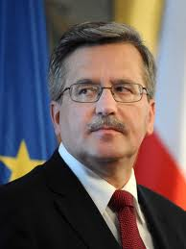
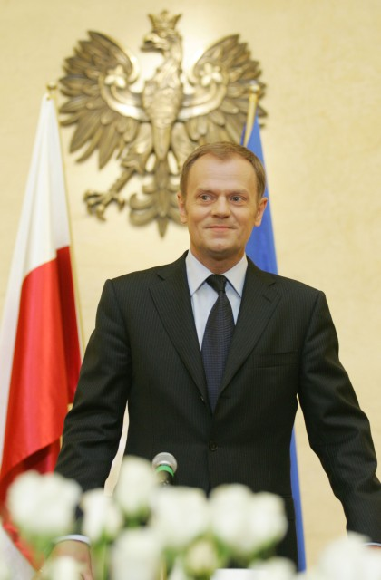
Political system: parliamentary republic
President:
Bronisław Komorowski
Prime Minister:
Donald Tusk

Slide 8


Poland initiated the reform of its
political system and economy in 1989

Slide 9
The Constitutional name of the Cabinet is the Council of Ministers
(Rada Ministrów).
This body consists: the Premier, the vice-Premier(s), the Ministers, the chiefs of special committees.

Slide 10
The constitutional position of the Cabinet is rather strong
(governing of the country is divided into the Council and the President).
The Council of Ministers deals with issues not reserved for the other state authorities or local government.

Slide 11
The Prime Minister
(the Chief of government) along with the Ministers is directly involved in governing.

Slide 12
The Prime Minister and the Ministers are especially involved in conducting both internal affairs and foreign policy
(they make most of decisions in Polish policy)

Slide 13
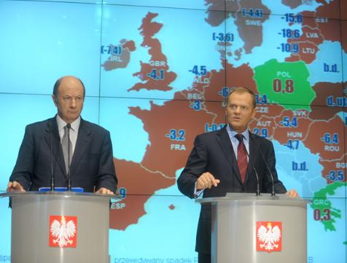
Economic policy - one of the main spheres of the Cabinet activities - especially clear as far as the state budget is concerned.

Slide 14
The Council of Ministers (under Polish Constitution) is the only authority allowed to issue a draft of the budget or any project changing it.
(The Parliament: the Sejm or the Senate, the President and any other bodies can not initiate budget changes!)

Slide 15
The size of the budget deficit decided on by the Cabinet can not be increased by parliamentary procedure
(the Parliament is able to reduce or raise some incomes and expensions which do not alter the basic assumptions of the budget submitted by the Council of Ministers!)

Slide 16
The Council's domination is expressed also in its ability to shorten the term of proceeding the budget compared to other statutes (parliament acts).

Slide 17
The Sejm has to finish its work within the period of 4 months from when the Council of Ministers has issued the draft of budget.
In the other case the President can dissolve the Parliament (both the Sejm and the Senate).

Slide 18
The President has to sign the budget within 7 days of it having been presented to him.
The President is not allowed to veto budget act!

Slide 19
Three levels of local administration
(administrative division of Poland): voivodeships (województwa) counties (powiaty) communes or municipialites (gminy)

Slide 20
voivodeships counties communes
Poland is divided into
16 voivodeships,
379 counties (including 65 cities with powiat status), and 2,478 communes*
* data on 31st of December 2009 (GUS – the Central Statistical Office of Poland)

Slide 21
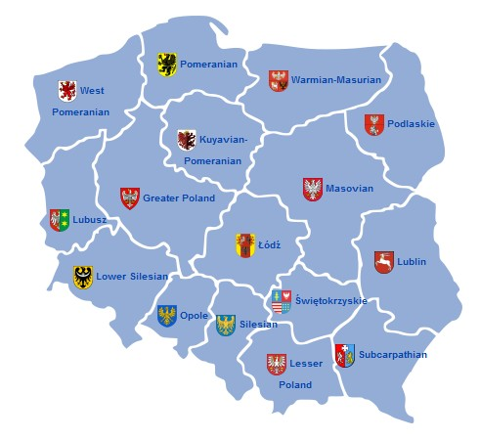

Slide 22
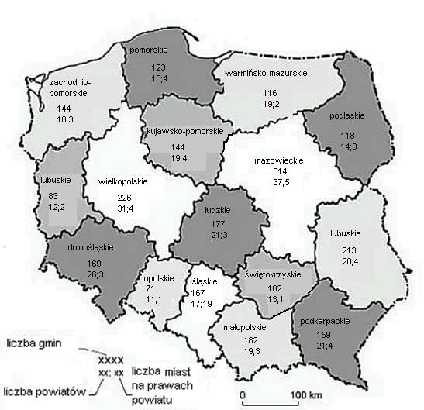

Slide 23
Voivodeships (województwa)
Competences at voivodeship level
are shared between:
voivode (governor - government-appointed),
regional assembly,
executive (elected by the assembly).

Slide 24
The voivode is appointed by the Prime Minister.
The voivode:
represents of the Council of the Ministers in voivodeships,
oversees the functioning of local government,
manages central government property in the region,
coordinates actions public safety and environment protection.

Slide 25
The regional assembly:
passes local statutes, including the voivodeship's development strategies and budget of the voivodeship,
elects the marszałek and other members of the executive.
The executive:
drafts the budget and development strategies, implements the resolutions of the regional assembly,
manages the voivodeship's property,
manages of EU funds.

Slide 26
Counties (powiaty)
Competences at county level are shared between: council, executive headed by starosta (elected by that council).

Slide 27
Counties have rather weak power, because many local and regional issues are dealt with either at commune or voivodeship level.

Slide 28
Competences of county authorities: education at high-school level, healthcare, public transport, work permits to foreigners, unemployment, vehicle registration

Slide 29
Communes or municipalities (gminy) the basic unit of administrative division of Poland!!!
Three types of communes in Poland: urban commune (one city or town), urban-rural commune (mixed: town and surrounding villages), rural commune (only villages)

Slide 30
Authorities of communes: municipal council or town assembly (rada gminy) the legislative and controlling body elected in every four years, mayor of the municipality
(wójt, burmistrz, prezydent miasta) the executive body directly elected in every four years

Slide 31
Two types of tasks (competences) of communes: own tasks commissioned tasks

Slide 32
Own tasks of communes public tasks exercised by self-government, concerned the needs of the local community
1. compulsory (obligation) – the commune can not resign from the task
– the public benefits of basic character,
2. optional (not obligation) – the commune can carry the task out in accordance with budget possibilities
– set out only to specific local needs

Slide 33
Examples of own tasks: public streets, bridges, squares and traffic systems, water supply systems and source, removal of urban waste, sanitary facilities, dumps and council waste, supply of electric and thermal energy and gas, public transport, health care, welfare, care homes, public education, cultural facilities, public libraries and cultural institutions, historic monuments conservation and protection, sports facilities and tourism, interaction with regional communities from other countries.

Slide 34
Commissioned tasks public tasks resulting from legitimate needs of the state, commissioned by central government to be performed by local authorities.
The tasks are handed over on the basis of statutory acts or by agreements between the self-government units and central government administration.

Slide 35
Examples of commissioned tasks:
ID (identification documents), getting marriage (civil and concordate), books of marriages, births and deaths.

Slide 36
Thank You ☺
GRAZIE

