Slide 1
The European Central Bank

Slide 2
Some references
DeGrauwe, Economics of Monetary Union, Oxford University press. (main chapters: 8 & 9)
Background Studies for the ECB’s Evaluation of its Monetary Policy Strategy, European Central Bank, November. P.10-29
http://www.ecb.int/pub/pdf/other/monetarypolicystrategyreview_backgrounden.pdf
The Monetary Policy of the ECB, 2nd edition 2004
http://www.ecb.int/pub/pdf/other/monetarypolicy2004en.pdf
ECB monthly bulletin
www.voeeu.org

Slide 3
Objectives for this week
To understand the origins of the European Central Bank (ECB)
To understand the functioning of the ECB
To analyse the policy of the ECB
To look at the unconventional monetary policy – ECB Vs. FED Vs. BofE (time permitting)

Slide 4
Two models of central banking
Two models of central banking
Anglo-French model versus German model
These models differ with respect to
  Objectives pursued
  Relations with government

Slide 5
Objectives of central bank
In the Anglo-French model, the central bank pursues several objectives.
Price stability is only one of the objectives and does not receive any privileged treatment.
In the German model price stability is considered to be the primary objective of the central bank.

Slide 6
Relations with the government
In Anglo-French model,
  the monetary policy decisions are subject to the government’s approval
  political dependence.
In German model,
  monetary policy decisions are taken by the central bank without interference of political authorities
  political independence
The German model prevailed in the design of the European Central Bank.

Slide 7
Statutes of the ECB
Objectives
  “The primary objective of the ECB is the maintenance of price stability” (article 105)
  Without prejudice to the objective of price stability, the ECB shall support the general economic policies in the Community with a view to contributing to the achievement of the Community as laid down in article 2. (Article 105(1).)
Political independence
  Enshrined in article 107: “The ECB (…) shall not seek nor take instructions from Community institutions or bodies, from any Government of a Member State or from any other body”.
The Treaty also recognizes that political independence is a necessary condition for ensuring price stability.

Slide 8
Why has the German model prevailed?
Two reasons:
  intellectual development, i.e. the ‘monetarist counter-revolution’
  strategic position of Germany in the process towards EMU
In order to accept EMU, the German monetary authorities insisted on having an ECB that gives an even higher weight to price stability than the Bundesbank did.
This victory was greatly facilitated by the fact that most central bankers had been converted to monetarism

Slide 9
The Barro-Gordon model and optimal stabilisation
Inflation equilibrium in point A
Unemployment is at its natural level
Authorities have no incentive any more to create surprise inflation.
The upward sloping dotted line is the optimal stabilization line.
Slope of the optimal stabilization line is determined by the weight the authorities attach to the stabilization of unemployment.
The higher this weight the steeper is stabilization line
With a steep stabilization line authorities stabilize a lot at the cost of a high inflation bias
An upward shift in Phillips curve leads authorities to stimulate economy so that effect on output is reduced at the expense of more inflation
π₁
B
A
B’
Inflation
C
U’
U
U_{N}
U₁
U₂
Unemployment

Slide 10
How to eliminate the inflation bias?
Appointing a conservative central bank
The steep stabilization line represents the preferences of society.
The flatter stabilization line is the one of the conservative central bank (Rogoff), the ECB.
On average Euroland will have lower inflation without any loss in employment.
However, there will be less concern for stabilization
This leads to a potential conflict between the ECB and elected politicians (or across nations)
Inflation
Euroland’s preferences
ECB preferences
U_{N}
Unemployment

Slide 11
The ECB: a ‘conservative’ central bank
Creation of ECB was dominated by fear of inflation bias.
This led to idea that ECB should be conservative, i.e. given overriding importance to price stability neglecting output and unemployment stabilization if necessary.
Is there evidence that ECB behaves in a more conservative why than the Fed?

Slide 12
Is there evidence that the ECB acted as a conservative central bank?
Figure 8.5 Policy interest rates in the Eurozone and the US (%)
US Fed seems to have reacted more to economic slowdown of 2001 than ECB (keeping interest rate too low for too long)
Then it reacted sharper to the boom of 2004-06 and the recession of 2007- 08 than the ECB

Slide 13
Eurozone
Figure 8.6 Short-term interest rate and output gap (1999–2010)
Eurozone
ECB does react to movements in output gap
Thus it gives some weight to output stablization
US Fed reacts more strongly to decline in output gap than ECB
It appears that Fed attaches greater weight to output stabilization than ECB
In this sense ECB is more conservative than Fed
Note that US Fed may have kept the interest rate too low during 2002-05
US

Slide 15
Figure 8.8 Inflation in Eurozone and in US
(1999– 2005) (%)
Previous conclusion is not affected by inflation experiences
Both US and Eurozone experienced similar inflation rates
Thus, the more cautious attitude of the ECB vis-à-vis output stabilization was not due to greater inflation risks in the Eurozone as compared to the US.

Slide 16
Conclusion: the ECB appears to be more conservative than the US Federal Reserve.
  it attaches greater importance to price stability and it is more cautious in reacting to movements in the business cycle than the US Fed.
This does not mean that the Federal Reserve followed better policies than the ECB.
There is now consensus among economists that the Fed’s monetary policies during 2001–04 were too expansionary for too long
  fueling a boom in the US housing market.
  contributing to a general consumption boom in the US.
  These booms have come to a spectacular end in 2007.

Slide 17
Independence and accountability
Whenever the government delegates power to the central bank there is a corresponding need to have accountability.
The reason is that the government maintains its full accountability towards the voter.
Thus it cannot afford to delegate power without maintaining control over the use of this power.
Independence and accountability are part of the same process of delegation.

Slide 18
Optimal relation between independence and accountability
Independence
ECB
Bundesbank
Fed
Accountability

Slide 19
ECB is more independent than any other major central banks.
The degree of accountability is weaker than in the FED.
This goes against the theory according to which accountability should be increased together with the degree of independence.

Slide 20
Accountability is also related to the degree of precision with which central bank’s objectives are specified.
  The Treaty is vague about the other objectives besides price stability.
  the ECB has interpreted this to mean that it has to pursue only price stability.
  As a result, the ECB has drastically restricted the domain of responsibilities about which it can be called to account.

Slide 21
Modern central banks have a wider responsibility than simply price stability.
Conflicts between the ECB and the European governments will arise when the ECB is perceived to act too little to avoid recessions and escalating unemployment.

Slide 22
What ECB could do to avoid conflicts
Enhancing informal accountability through greater transparency
Larger openness in the decision-making process
Inflation targeting promotes informal accountability.

Slide 23
The ECB: institutional framework
The Eurosystem consists of
  the European Central Bank (ECB)
  the national central banks (NCBs) of member countries
Governing bodies are
  the Executive Board
  the Governing Council.
Executive Board consists of President, Vice-President, and four Directors of ECB.
Governing Council consists of the six members of the Executive Board and the governors of the twelve national central banks.

Slide 24
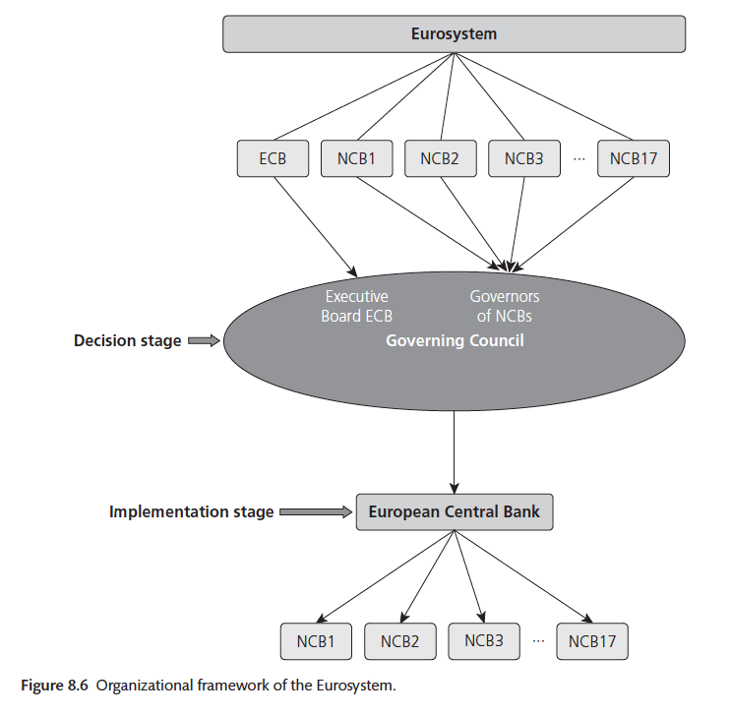

Slide 25
Governing Council is the main decision-making body of the Eurosystem.
It takes decisions concerning interest rates, reserve requirements, and the provision of liquidity into the system.
It meets every two weeks in Frankfurt. During these meetings, the 18 members of the Governing Council deliberate and take the appropriate decisions.
Each of the members has one vote.
  Note : with enlargement this will change

Slide 26
There is no qualified voting in the Governing Council.
The rationale is in the Treaty:
  members of the Governing Council should be concerned with the interests of Euroland as a whole, and not with the interests of the country from which they originate.
  Qualified voting would have suggested that the members of the Governing Council represent national interests.

Slide 27
The Executive Board of the ECB
  implements monetary policy decisions taken by the Governing Council.
  gives instructions to the NCBs.
  sets the agenda for the meetings of the Governing Council.
Thus, Executive Board has strategic position in the decision-making process in the Governing Council.

Slide 28
Is the Eurosystem too decentralized?
Is influence of the NCBs in the Governing Council too large so that national interests prevail at the expense of the system-wide interests?
In order to analyze this: compute Taylor rule for each central banker
  Taylor rule computes the interest rates that each of the national governors desire, given the economic conditions that prevail in their own country.
Assume that the ECB Board applies the Taylor rule, using Eurozone wide aggregates of inflation and output gap.

Slide 29
Taylor rule
r_{t}* is the desired interest rate,
ρ is the long-term real interest rate,
is the inflation target and
x_{t} is the output gap.

Slide 31
Asymmetric distibution of desired interest rates using Taylor Rule (2007)
Without ECB-Board
Without ECB-Board
Assumptions:
Governors are nationalistic
ECB-board cares about Euro-wide interests
ECB-Board only needs three votes to find majority for its proposal
ECB-Board has strategic position despite asymmetries in shocks
With ECB-Board
With ECB-Board

Slide 32
Conclusion of previous analysis
Today the ECB-Board has strategic position within Governing Council. (Its interest rate proposal is close to median.)
This is maintained even when distribution of desired interest rates is very different among large and small countries.
This decision making process ensures that the interest rate that is decided is the optimal one from the point of view of the Eurozone as a whole.

Slide 33
This is so even if national governors are guided by economic conditions prevailing in their own countries.
This decision making model also ensures that large countries’ (France, Germany, Italy) interests are relatively well served, despite the overrepresentation of the small countries in the Governing Council.
Consensus is easy to reach and formal voting usually unnecessary.

Slide 34
In enlarged Eurozone the ECB-Board will lose its strategic position.
Its interest rate proposals will occasionally be overruled by coalitions of small countries who experience different economic conditions than the average (which is dominated by the large countries).
Interest rate decisions will be made on the basis of economic conditions that prevail in a relatively small part of Euroland.

Slide 35
This will lead to conflicts within the Eurosystem.
Consensus model is likely to break down.
The essence of the problem: small countries are over-represented in the Governing Council.
in an enlarged Eurosystem this will have a fatal effect that interest rate decisions may not always be made on the basis of the average economic conditions that prevail in the union.

Slide 36
How to reform the decision making process within an enlarged Eurosystem?
With the enlargement the over-representation of small countries will have to be reduced.
This can be achieved in several ways.
  The US Fed formula: all governors participate in deliberations of Governing Council but voting rights are limited to a limited number of governors on a rotating basis.
  The IMF formula: small countries group together in constituencies and are represented by one governor.
  The centralized formula: the decision making is restricted to the Executive Board of the ECB. In this formula there is some scope for expanding the size of the Board.

Slide 37
On 20 December 2002 the Governing Council reached agreement that combines first and second formulas.
  Number of governors with voting rights will be limited to 15. The members of the Executive Board will maintain their voting rights.
  The governors will exercise their voting rights on a rotating basis. Frequency with which they can participate in the voting will depend on the relative size of the country they come from. Thus governors of large countries will exert their voting power more frequently than governors from small countries.
This proposal has been adopted by the Heads of State.
This new system will be put into effect as soon as the number of national governors exceeds 15.
This was achieved on 1 January 2009 when Slovakia became the 16th member country.
However, the Governing Council decided to postpone the implementation of the rotating system until the number of member countries exceeds 18.
Why this decision was made is unclear.

Slide 38
Bank supervision and financial stability in the Eurozone
Principle of home country prudential control
Principle of host country responsibility for financial market stability
These two principles might conflict in a increasingly integrated market.
This peculiar way of organizing the supervision of banks is inefficient.

Slide 39
Over the last decade the banking system has internationalized significantly (not only in the Eurozone, but also elsewhere).
See figure in next slide.
The degree of cross ownership is such that the peculiar way of organizing the supervision of banks is inefficient.
In fact it may have contributed to the banking crisis.

Slide 41
National authorities are responsible for the stability of the banking system in their own countries.
  Thus they need information on the soundness of the banks operating in their territory so as to detect banking problems.
  A significant part of that information (if at all), however, is held by the supervisory institutions in other countries.
  Experience shows that institutions tend to guard information jealously.
  Thus, national authorities responsible for maintaining financial stability are badly informed about large numbers of the banks operating in their territory.
The supervisory system in the Eurozone has failed and has contributed to the banking crisis that erupted in 2007-08.

Slide 42
Banks have profited from this situation, in many ways.
The lack of effective supervision has allowed banks to expand their balance sheets and to take on excessive risks.
See figure next slide showing the expansion of the balance sheets of major banks in Europe (not only the Eurozone).
Balance sheets of major European banks experienced explosive development
Thus the problem of inadequate supervision and regulation is a general one affecting the banking systems in all countries where banks have increasingly internationalized.

Slide 44
Banks are inherently fragile
Basics of banking
  Banks borrow short and lend long
  This creates inherent fragility
  No problem in normal times, i.e. when people have confidence
  Problem when confidence disappears
  Confidence disappears when one or more banks experience solvency problem (e.g. bad loans)

Slide 45
  Then bank run is possible : liquidity crisis involving other, sound banks (innocent bystanders)
  A devilish interaction between liquidity crisis and solvency crisis arises: sound banks have to sell assets to confront deposit withdrawals
  Fire sales lead to asset price declines which
    reduces value of banks’ assets
    leads to solvency problem
    and can bring further liquidity crisis
Internationalization and financial innovation have allowed banks to search for more return by taking on excessive risks. In particular by massively increasing leverage (debt to equity ratio) and funding in interbank market.
European supervisors have allowed this to happen.

Slide 47
Present supervision and regulation of the banking system is totally inadequate to prevent crises in an environment in which banks have become increasingly international
Although the problem also exists in non-Eurozone countries, it is more acute within the Eurozone
  where one central bank has to conduct monetary policy for the area as a whole
  and where it has to provide liquidity (as lender of last resort) when a crisis erupts
Since the banking crisis of 2008 the need to centralize regulation and supervision had become so obvious that also the European policymakers took steps in that direction. This led in 2011 to a new regulatory and supervision structure in the EU that we describe in the next section.

Slide 48
The new financial regulatory and supervisory structure in the EU
The banking crisis of 2008 has been the trigger to a fundamental overhaul of the way banks and financial markets are regulated and supervised in the Eurozone and in the EU.
It should be noted that the new framework applies to all EU countries and thus is not restricted to the Eurozone.

Slide 49
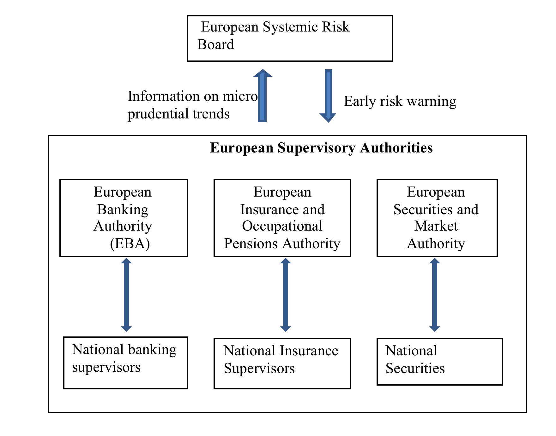
New European Regulatory structure

Slide 50
On the whole these are important institutional changes that give significant powers to European authorities.
But, national supervisors maintain their powers for the day-to-day supervision of the institutions and markets under their jurisdiction.
They will, therefore, also continue to have privileged access to information.
The question arises about how smooth the information sharing between national and European authorities will be in practice.
Experience shows that those who have the primary access to information are often reluctant to share this information.
Only the future will tell whether this new institutional structure will be more effective to prevent and to manage crises.

Slide 51
Conclusion
The strong degree of independence of ECB (a positive thing) is not matched by equally strong procedure to control the performance of the ECB.
Lack of a centralized supervision of the banking system in the Eurozone helps to explain the severity of the banking crisis that emerged in 2007-08.
As a result of banking crisis of 2008, the European leaders have set up a new European regulatory and supervisory structure that should correct for the failures of the old structure.

Slide 52
The old structure was based on national regulation and supervision of a financial system that had become increasingly international.
The lack of a centralized supervision of the banking system was certainly a contributing factor in explaining the severity of the banking crisis that emerged in 2007–8.
One can only hope that the new European regulatory and supervisory structure will be more effective than the old nation-based one, in preventing and managing financial crises.

Slide 53
Monetary Policy in Euroland

Slide 54
Monetary policy when asymmetric shocks occur
In an optimum currency area few asymmetric shocks occur.
ECB has a relatively easy time to stabilize shocks.
There are few conflicts between member-states and the ECB.
This can be illustrated by two simple graphs

Slide 55
Symmetric shock and monetary policy of the ECB
France
Germany
price
price
S_{F}
S_{G}
P_{F1}
P_{G1}
D_{G}
D_{F}
Y_{F1}
Y_{G1}
output
output

Slide 56
Asymmetric shock and monetary policy of the ECB

Slide 57
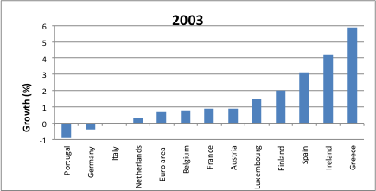
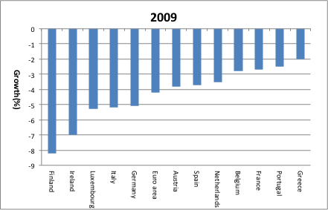
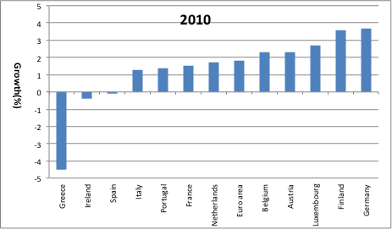
Have asymmetric shocks been important in the operation of the Eurosystem? Output gaps
Source: European Commission, European Economy

Slide 58
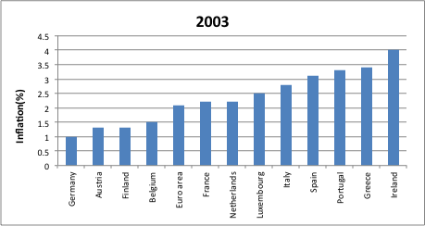
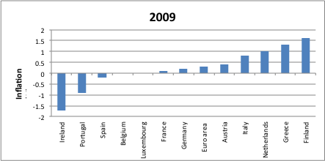
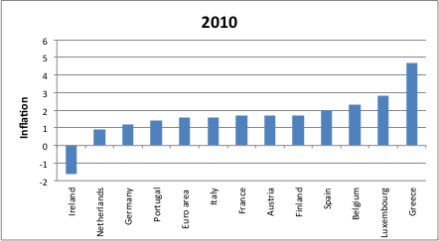
Have asymmetric shocks been important in the operation of the Eurosystem? Inflation
Source: European Commission, European Economy

Slide 59
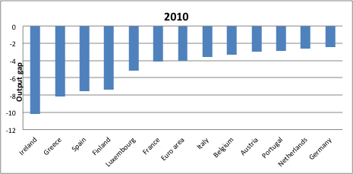
Output gap is a good measure of the business cycle position of countries
Output growth differences also reflect permanent asymmetric shocks (e.g. productivity growth differences)
A measure of temporary shocks (business cycle) is provided by the output gap
We observe large differences
These differences in inflation and output gap experiences lead to different desired interest rates of different countries
We can measure these different desired interest rates using the Taylor rule
Output gaps in the Eurozone in 2007 (%)

Slide 60
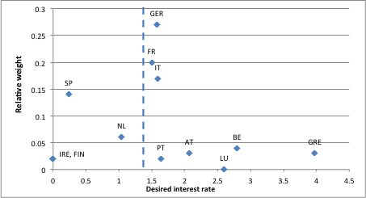
Wide range of desired interest rates in 2010
ECB computes average desired interest rate
Many countries are likely to be less than enthusiastic about the interest rate decisions of the ECB.

Slide 61
Asymmetric shocks and housing prices
Large inflation differences within Eurozone
Combined with the same nominal interest rate in the Eurozone
Create large differences in real interest rates

Slide 62
Large differences in real interest rates in Eurozone ...
Average real interest rates in Eurozone countries (1997–2007)

Slide 63
... create large differences in house price inflation
House price indices (% change over 1997–2008)

Slide 64
Real interest rate and house prices (% change) 1998–2008

Slide 65
The Monetary Policy Strategy of the ECB: a description
Monetary Policy Strategy (MPS) of ECB consists of two parts:
  A definition of the objectives
  The instruments to achieve these objectives.

Slide 66
The objectives
The Governing Council of the ECB has adopted the following definition:
  ‘price stability shall be defined as a year-on-year increase in the Harmonised Index of Consumer Prices (HICP) for the euro area of below 2%’.
Thus target range of inflation is 0% to 2%.
However, recent ‘clarification’: “inflation should remain below but close to 2%
‘medium run’ objective
  The ECB does not define what the ‘medium run’ is.
No mention of other objectives

Slide 67
The instruments
Two pillars
First pillar: Money stock is reference value
  M3 reference value: 4.5%
  The European Central Bank's definition of euro area monetary aggregates:
  * M1: Currency in circulation + overnight deposits
  * M2: M1 + Deposits with an agreed maturity up to 2 years + Deposits redeemable at a period of notice up to 3 months
  * M3: M2 + Repurchase agreements + Money market fund (MMF) shares/units + Debt securities up to 2 years
implicit model (quantity theory equation in log-linear form):
m + v = p + y
Δm + Δv = Δp + Δy
Δm = Δp* + Δy^{f} - Δv^{f} (Δp*=2%; Δy^{f} =2%, Δv^{f} =-0.5% ➔ Δm=4.5%)
Same procedure of Bundesbank

Slide 68
The second pillar
Second pillar
Other reference values
  wages
  energy prices
  exchange rate
  yield curve
  possibly other variables

Slide 69
The Monetary Policy Strategy of the ECB: an evaluation
The selection of the target
(Is inflation target of at most 2% too low?)
Two-pillar strategy

Slide 70
Selection of the target
In interpreting its mandate ECB has been influenced by the theory of flexible inflation targeting as developed by Svensson (1996, 2000).
The central claim made by this theory is that by stabilizing the price level, the central bank also stabilizes the output level.
In this view there is no need to target output explicitly.
Not consistent with mandate set out in Maastricht Treaty.

Slide 71
Selection of target
If we accept the narrowing down of the ECB’s responsibility to inflation
the ECB has been quite successful in achieving the objective of price stability.
See figure in next slide
Apart from a few spikes in inflation (the most important one during July 2007 and July 2008), success is unmistakable.
During the whole period of its existence (1999-2008) the ECB kept inflation on average equal to 2.2%.

Slide 72
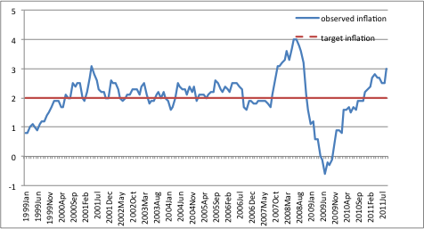

Slide 73
What do we learn from this?
First, the ECB was successful in keeping inflation low despite the fact that it completely failed in its announced strategy to control inflation via monetary control.
Second, it tells us much about the signaling power of money growth in the Eurozone.
  Prior to financial crisis (2008): M3-growth had almost no power in predicting future inflation in the Eurozone, and exceeded by far target of 4.5%.

Slide 74
  After crisis (2008): growth rate of M3 collapsed and dropped way below its reference value of 4.5%
  Inflation drops significantly in 2008
  M3 growth became a better predictor of inflation, i.e. the strong decline in money growth coincided with a significant decline in inflation during 2008-09.
  But inflation started to increase before the (small) increase in growth M3

Slide 75
Shocks in aggregate demand and supply
Demand shock
Supply shock
AS’
AS
AS
Price level
Price level
AD’
AD
AD
Normal Output
Output
Normal Output
Output

Slide 76
When demand shocks occur, inflation targeting stabilizes prices and output.
Not so when supply shocks occur; in this case there is tradeoff between output and inflation stabilization.
ECB has made clear that when such a tradeoff occurs it will choose inflation stabilization.
Even then gradualism can be applied.

Slide 77
Is the inflation target of at most 2% too low?
Answer : Probably Yes
Rapid technological progress changes the conventional measures of inflation
  The true inflation rate is overestimated by 0.5% to 1.5% a year (quality bias).
Some inflation is good for the economy
  It works as a lubricant and allows for more flexible adjustments in real wages.
  Argument is based on money illusion
Large differences in inflation together with low target pushes inflation in some countries close to zero, possibly below zero

Slide 78
Conclusion
2% maximum inflation rate is too low.
The idea of setting a maximum rate is not a good one.
  The economy is subjected to shocks.
  a precise control of the rate of inflation very difficult.
  setting a maximum rate creates an issue of credibility.

Slide 79
A different target is necessary
ECB should redefine its target to be a number between 2 to 3%
Then it should allow some flexibility around this new target in a symmetric way
This is the approach taken by the Bank of England (target = 2.5%, with some leeway above and below it)

Slide 80
Since the financial crisis of 2007-08 there is a new question: Is financial stability not equally, if not more important as an objective of the central bank?
Before the crisis, the standard response was:
  first, by maintaining price stability the central bank did all it could do to maintain financial stability.
  second, the main responsibility for maintaining financial stability is in the hands of the supervisors and regulators.
Responsibility of the supervisors and the regulators is serious.
But this does not absolve the central bank from its responsibilities.
Because there is a tradeoff between price stability and financial stability
The central bank has to make a choice: price stability or financial stability.

Slide 81
Tradeoff between price stability and financial stability: IT bubble
IT-shock leads to shock supply and demand.
We assume supply shocks larger.
Central bank targets P* and thus stimulates demand further.
This leads to further asset bubble.
Point C unsustainable
Crash will occur.

Slide 82
The tradeoff arises because the technology shock has the effect of reducing the aggregate price level.
The central bank, however, targets a price level corresponding to the pre-technology shock.
As a result it reacts to the shock by a monetary stimulus,
creating an environment that makes a bubble more likely,
while keeping the price level unchanged.

Slide 83
Other booms and busts are possible.
These can be intensified when the central bank only targets inflation.
Major central banks (including the ECB) focused mainly on price stability, and were quite successful in keeping inflation low.
They failed, however, to see the bubbles in asset markets that were threatening financial stability, and that they fueled inadvertently by allowing excessive credit creation to develop.

Slide 84
How to define and to monitor financial stability?
Defining price stability is easy.
Not so for financial stability.
Monitoring of financial stability is inherently more difficult than the monitoring of price stability.

Slide 85
Borio and Lowe (2002) define financial instability as twin phenomenon:
  rapid credit growth combined with
  large increases in asset prices increases the probability
Simultaneous occurrence of bubble-like developments in asset markets and excessive credit growth as twin indicators of threats to financial stability is also to be found in Kindleberger (2000).
Thus, the argument that one cannot identify bubble ex ante is weak.

Slide 87
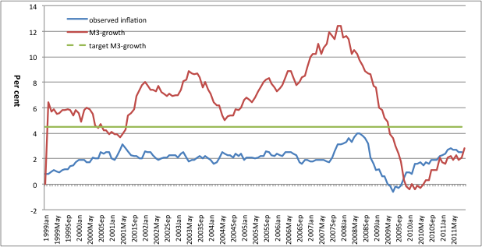
Source: ECB Monthly Bulletin

Slide 88
What do we learn from this?
First, the ECB was successful in keeping inflation low despite the fact that it completely failed in its announced strategy to control inflation via monetary control.
Second, it tells us much about the signaling power of money growth in the Eurozone.
  M3-growth has had almost no power in predicting future inflation in the Eurozone since 1999.

Slide 89
Why has money growth so little information value for future inflation?
In a low-inflation environment
and in a world of frequent financial innovations
the money supply numbers are very unreliable as signals of future inflation
  Movements in money data dominated by noise coming from financial innovations and disturbances

Slide 91
Rapid expansion of M3 after 2005 signaled something very different than future inflation.
It was a signal of future financial upheavals.
The expansion of M3 was counterpart of the massive expansion of the balance sheets of banks.
Banks were allowed to increase their risky credit portfolios both nationally and internationally in an unprecedented way.
Their balance sheets became closely linked to the consecutive bubbles that were going on in asset markets (real estate markets, stock markets, commodities markets).

Slide 92
Thus the spectacular expansion of M3 (which reflects broadly the liabilities side of the banks, i.e. deposits etc.) was the mirror image of the bubble driven expansion of bank credit (the asset side).
This expansion of the balance sheet of banks did not lead to inflation in the consumption goods but to inflation in asset markets, until the bubble bursts.

Slide 93
Single minded focus of the ECB on inflation worked as a blind spot,
preventing it from seeing that the danger did not come from CPI-inflation but from asset inflation.
As a result, it did not use information coming from M3 to stop the bubble.

Slide 94
What do we learn from this?
First, the ECB was successful in keeping inflation low despite the fact that it completely failed in its announced strategy to control inflation via monetary control.
Second, it tells us much about the signaling power of money growth in the Eurozone.
  Prior to financial crisis (2008): M3-growth had almost no power in predicting future inflation in the Eurozone, and exceeded by far target of 4.5%.

Slide 95
Inflation targeting: a model for the ECB?
Instrument Intermediate target Ultimate target
MS-targeting
Interest rate
Money stock
Inflation
Inflation forecast
Inflation
Inflation-targeting
Interest rate
Inflation targeting is superior to money stock targeting (see Svensson (1998)).
The reason is that with inflation targeting the central bank uses information of all the variables (including the money stock) that will affect future inflation.
The inflation forecast is then the best possible intermediate target.

Slide 96
But inflation targeting must be supplemented with policies aiming at preventing asset bubbles from destabilizing banking system
Inflation targeting alone does not achieve this.

Slide 97
a new ‘two-pillar’ strategy
In the first pillar, the central bank targets the rate of inflation.
  This is the pillar that has to be used in normal times.
In the second pillar, the central bank keeps track of bank credit and asset prices (stock prices and real estate prices).
In this new two-pillar approach the ECB is responsible to limit the movements in bank credit.
In order to do so it will need sufficient instruments.
We return to this issue.

Slide 98
The instruments of monetary policy in the Eurozone
Three types of instruments:
open market operations
standing facilities (credit lines)
minimum reserve

Slide 99
Direct buying and selling of marketable securities
Is not traditional tool of ECB (contrast with FED and BoE)
ECB started using this technique when it bought government securities in secondary markets in 2011
Huge outcry among German economists
Pretending this was illegal
It is not

Slide 100
Did the ECB violate its statutes when it bought government bonds ?
Article 18 of the Protocol on the Statute of the European System of Central Banks and the European Central Bank :
“the ECB and the national central banks may operate in financial markets by buying and selling (..) claims and marketable instruments”.
Government bonds are marketable instruments

Slide 101
The Eurosystem as lender of last resort during the financial crisis
In October 2008 the banks in the Eurozone were gripped by a full-scale liquidity crisis.
The collapse of Lehmann Brothers brought a number of European banks into difficulties.
They had to sell assets, thereby creating solvency problems for themselves and other banks.
As a result, deposit holders (especially in the interbank markets) withdrew their money precipitating a liquidity crisis.

Slide 102
The Eurosystem stepped in with massive liquidity injections, using both open market operations and marginal lending facilities.
These liquidity injections succeeded in averting a collapse of the banking system.
The Eurosystem stood its first big test as a lender of last resort in times of crises.
It repeated this in December 2011

Slide 103
One important implication of these liquidity injections is that the balance sheet of the Eurosystem expanded massively.
When Eurosystem performs open market operations it provides liquidity to the banks by accepting eligible assets as collateral.
Thus, the Eurosystem acquired large amounts of assets previously held by banks in the Eurozone.
Balance sheet of Eurosystem exploded.

Slide 104
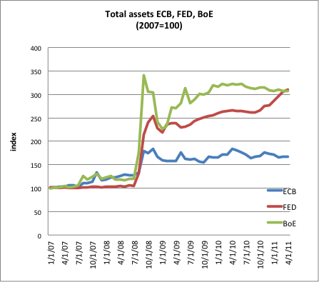

Slide 105
Lender of last resort in government bond market
ECB did not take up role of lender of last resort in government bond markets.
It is essential that the ECB take on this role in the government bond markets in the Eurozone,
  because the latter are characterized by the same fragility as the banking sector.
  i.e. the governments issue liquid liabilities (government bonds) while most of their assets are illiquid.
  This feature makes them prone to self-fulfilling liquidity crisis, except if the central bank stands ready to provide the liquidity in the government bond market

Slide 106
ECB has been buying government bonds in secondary markets occasionally (e.g. Italian, Spanish, Greek bonds)
But did it hesitantly
And announcing that it would be limited on size and time
This creates wrong signal: investors fearing future halt in buying program, accelerated selling

Slide 107
Expansion of the balance sheet of the Eurosystem creates problems
Inflation risk
Potential losses
Moral hazard
When the system risks imploding central bank should set these concerns apart

Slide 108
Bagehot doctrine
Central bank should provide liquidity to banks that are solvent but illiquid
Liquidity provision then should be unlimited
If bank is insolvent, no liquidity support

Slide 109
Problem with Bagehot doctrine
It is often difficult to distinguish between liquidity and solvency crises.
When sovereign debt crises erupt these are often mix of liquidity and solvency problems.
  Liquidity crises raise the interest rate on the debt issued by governments and therefore quickly degenerate into solvency problems.
  Solvency problems often lead to liquidity crises that intensify the solvency problem.

Slide 110
Paradox
If it is easy to separate liquidity from solvency problems, the markets would also find it easy to do so.
If a government came under pressure, financial markets would be able to determine whether this government suffered from a liquidity or solvency problem.
  If they determined it was a liquidity problem, they would be willing to provide credit to the government. The central bank would not have to step in.

Slide 111
  If they determined it is a solvency problem, they would not want to provide credit and rightly so.
  The Bagehot doctrine would come to the same conclusion: the central bank should not bail out the insolvent government.
  The conclusion is that if solvency and liquidity crises can be separated, there is no need for a lender of last resort.

Slide 112
Moral hazard and penalty rate
Bagehot doctrine can used by the common central bank in a monetary union.
Bagehot put forward principle that in times of crisis, central bank should provide unlimited liquidity at a penalty rate.
The latter was seen by Bagehot as a way to take care of the moral hazard problem.

Slide 113
Application in Eurozone
The ECB could apply this principle by committing itself to provide unlimited liquidity as soon as the government bond rate of country A exceeds the risk free rate (say the German bond rate) by more than, say, 200 basis points (it could also be another number).
This could be a way in which the ECB takes care of moral hazard concerns.

Slide 114
Operational note
The open market operations are operations not geared towards the support on one particular bank.
They are designed to provide liquidity in the market in a non-discriminatory way.
During liquidity crisis NCBs may provide emergency liquidity assistance (ELA) to particular illiquid (but solvent) banks.
The provision of ELA is undertaken at the discretion of the competent NCB, and only in exceptional circumstances.
This facility has been used in different countries.
National governments bear the potential losses.

Slide 115
Conclusion
Objective of ECB was to keep inflation low.
It has achieved this objective up to now.
ECB had also announced that it would achieve low inflation by closely watching the growth rate of M3.
M3 has played no useful role in the ECB’s anti-inflation strategy.
The massive expansion of M3 before 2008 did not announce inflation, but a massive buildup of the balance sheets of the banks in the Eurozone.
This expansion reflected bubbles in various asset markets.
It should have warned the ECB

Slide 116
Major responsibility of the financial crisis is to be found in a failure to supervise and to regulate banks.
But it is also true that the ECB bears part of the responsibility.
Its excessive focus on inflation prevented it from taking action aimed at checking the ballooning expansion of bank credit.
The ECB should widen its objectives and include financial stability explicitly as an objective at par with price stability.
We also discussed the instruments that could be used to achieve this dual mandate.

Slide 117
The banking crisis of October 2008 has severely tested the capacity of the Eurosystem to be a lender of last resort.
It has injected liquidity massively and in a timely way, thereby averting a full scale banking crisis.
Thus, while the Eurosystem was unable to avert the banking crisis, it was successful in preventing this crisis from leading to a collapse of the banking system.

Slide 118
However, when the government debt crisis erupted in 2010 the ECB mainly stood on the sidelines.
It initiated a government bond purchasing program (SMP) but applied this with great hesitations, and announced that this would be temporary.
The effect of this was that the program lacked credibility, inducing investors to continue to sell government bonds and forcing the ECB to buy large amounts of these bonds.

Slide 119
The right approach would have been for the ECB to announce its full commitment to buying government bonds making it clear that it would use its unlimited capacity to create liquidity to stabilize bond prices.
Such a strategy would have created confidence in the market that bond prices would stop falling.

Slide 120
Unconventional monetary policy

Slide 121
Outline
A recap of the three-step conventional monetary policy transmission.
Monetary policy transmission channels: interest rate channel, exchange rate channel, asset price and credit channels.
Unconventional monetary policies and their transmission channels.

Slide 122
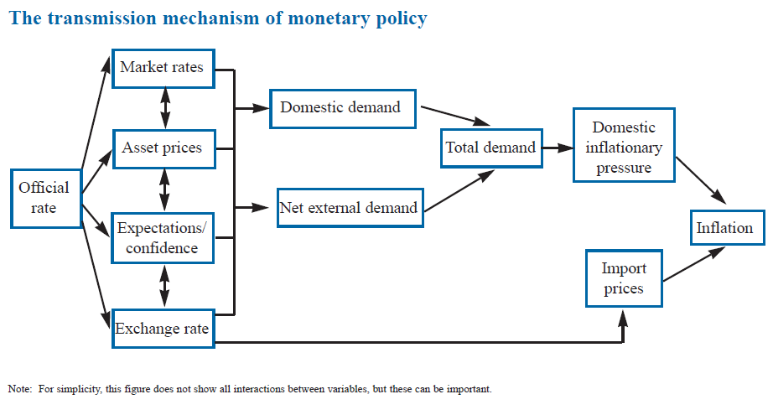
http://www.bankofengland.co.uk/publications/Documents/other/monetary/montrans.pdf

Slide 123
Financial Crisis
Lenders in the US (and UK) started offering mortgages to borrowers with poor credit histories (the sub prime borrowers)
A large share of these borrowers defaulted on their loans when interest rates increased
As the economy slowed and house prices fell, Banks wrote off the value of their loans
As financial companies in many other countries had purchased financial products linked to the US housing market, the crises quickly spread.

Slide 124
Banks didn’t want to lend to each other as they didn’t know other banks exposure to the crisis
The cost to banks of borrowing increased sharply
Banks tried to reduce the size of their loan books and started lending less to households and businesses.

Slide 125
Interest rate policy
US Fed cuts official rate from 5.25% to a range fluctuating around 0% to 0.25% during 2007 to 2009.
UK BoE lowered official rate from 5% to 0.5% from 2008 to 2009.
When the short term nominal interest rate reaches 0%, a central bank can try to rely on unconventional policy to stimulate the economy.

Slide 127
Is there evidence that the ECB acted as a conservative central bank?
Figure 8.5 Policy interest rates in the Eurozone and the US (%)
US Fed seems to have reacted more to economic slowdown of 2001 than ECB (keeping interest rate too low for too long)
Then it reacted sharper to the boom of 2004-06 and the recession of 2007- 08 than the ECB

Slide 129
Unconventional monetary policies
A key feature for unconventional monetary policies is that the central banks use their balance sheet actively to affect market prices and conditions.
Unconventional monetary policies are also described as balance sheet policies.
Krugman et al. (1998) - central bank should stimulate the economy by raising expectation of future inflation, but how?
Bernanke et al (2004) – three complementary monetary policy strategies when the interest rate approach zero

Slide 130
Unconventional monetary policies
Communication policies to shape public expectations.
Increasing central banks balance sheet beyond the level needed to set policy rate to zero. (Quantitative easing)
Shifting the composition of central banks’ balance sheet to affect relative supplies of securities held by public (Credit easing)

Slide 131
Communication policies
Interest rate approaches zero, but may still be high due to deflationary pressures.
Long-term interest rates and yields that are important for investment and spending.
Central bank has less control on long term interest rate, but they can influence long term interest rates and yields by Communication.
Committing to a low interest rate policy over longer term can support investment and asset prices.
Conditional commitment and unconditional commitment

Slide 132
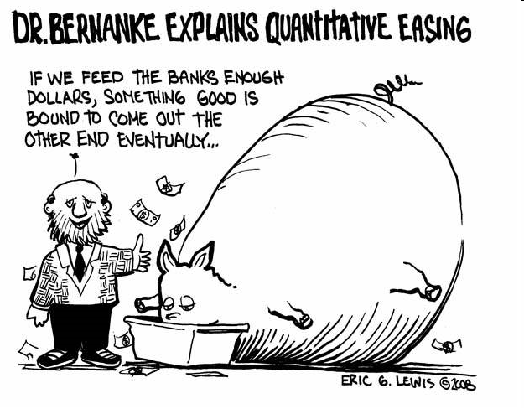

Slide 133
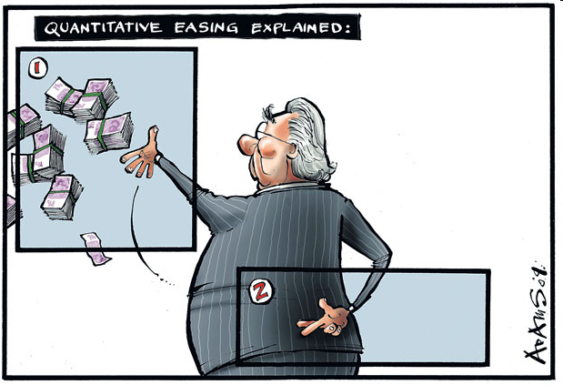
Mervyn King, Governor of the Bank of England, explains QE

Slide 134
Quantitative easing
Bernanke et al (2004) describes quantitative easing as policies which increase the size of the central bank balance sheet beyond the level needed to set policy rate to zero.
BoE defines QE as central banks buying public and private sector financial assets using central bank money.
Others define it as asset purchases financed by an expansion of the monetary supply.
It is also defined as monetary policy action which leads to an increase in the monetary base.

Slide 135
Quantitative easing
QE can be achieved by paying interest on reserve balances of depository institutions held in central banks.
No banks will lend to other banks at a lower rate than the deposit rate.
Central banks supply reserves without driving market interest rates below deposit rates.

Slide 136
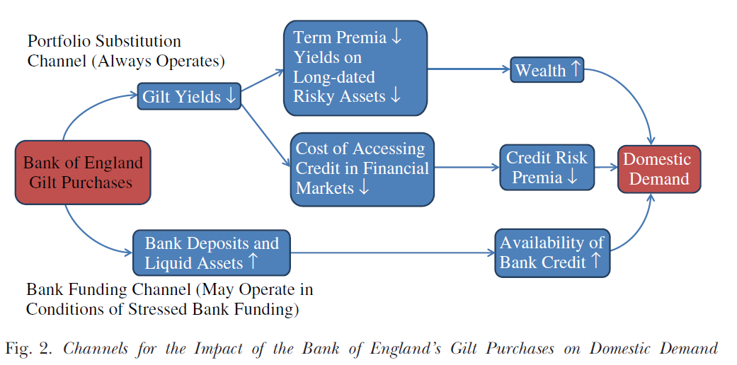
Joyce, M. , D. Miles, A., Scott and D. Vayanos., 2012. Quantitative eacing and unconventional monetary policy – an introduction. Economic Journal, Vol. 122

Slide 137
Quantitative easing
QE effect is highly uncertain.
QE may be complementary to communication policies in shaping of private sector expectations of future short term interest rates or price levels.
QE provides a visible signal to the public about central banks’ intention for future prices and makes low interest rate policy more credible (Bernanke and Reinhart, 2004).

Slide 138
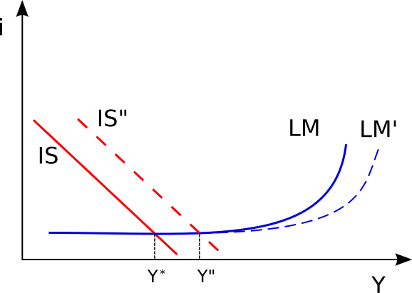
But QE may not be enough to avoid the liquidity trap

Slide 139
Credit easing
Central banks can shift the composition of their balance sheets to affect relative demand/supply of securities.
Such transactions influences term premiums, liquidity premiums and risks associated with different securities.
Central bank purchases target assets or specific segments of securities market.
The goal is to alter composition of private sector balance sheets by changing the central bank’s exposure to private sector claims.

Slide 140
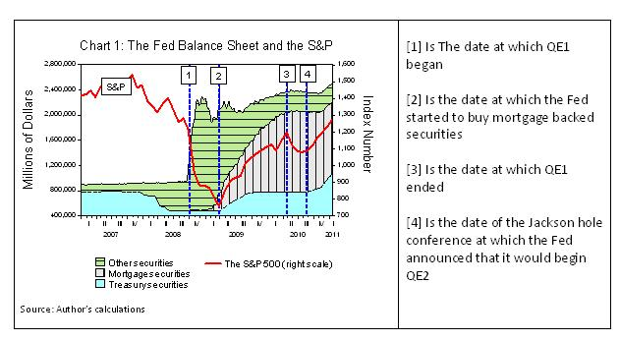
http://blogs.ft.com/economistsforum/2012/05/central-banks-should-do-much-more/

Slide 141
Examples of UK unconventional monetary policies
December 2007, BoE offered additional 3 month repos against wider collateral,… AAA residential mortgage backed securities and covered bonds.
April 2008, BoE introduced Special Liquidity Scheme (SLS) to allow banks to swap high-quality but temporarily illiquid MBS for more liquid UK treasury bills.
October 2008, Discount window facility (DWF) was introduced for banks to borrow long term government security (gilts) against a wide range of collateral for a fee.
January 2009, Asset Purchase Facility (APF) was set up to buy high-quality assets financed by the issue of Treasury bills. When the APF is used for monetary policy purposes, purchases of assets are financed by the creation of central bank reserves.

Slide 142
Securities Market Programme
The Euro Area experience
Similar but distinct from QE
  Buy sovereign debt
  Stabilize “dysfunctional” market segments
  Restore monetary policy transmission mechanisms
  3 and 6 month liquidity cycles
  Liquidity re-absorbed through other ECB operations
Notes:
Alli

Slide 143
Risks of Asset Purchase Programs
Quantitative Easing
SMP
Possible inflation risks, especially if GDP growth does not keep up with the new issuance of debt
Banks and other institutions don’t circulate the newly acquired cash
Banks invest their cash overseas or in speculative markets
Prolonged low interest rates may lead to financial bubbles in the future
ECB balance sheet is more risky in the case of Euro member default
Banks and other institutions don’t circulate the newly acquired cash
Banks invest their cash overseas or in speculative markets
Prolonged low interest rates may lead to financial bubbles in the future
Decreases fiscal agility of ECB in other areas
Notes:
Alex

Slide 144
Risk premia

Slide 145
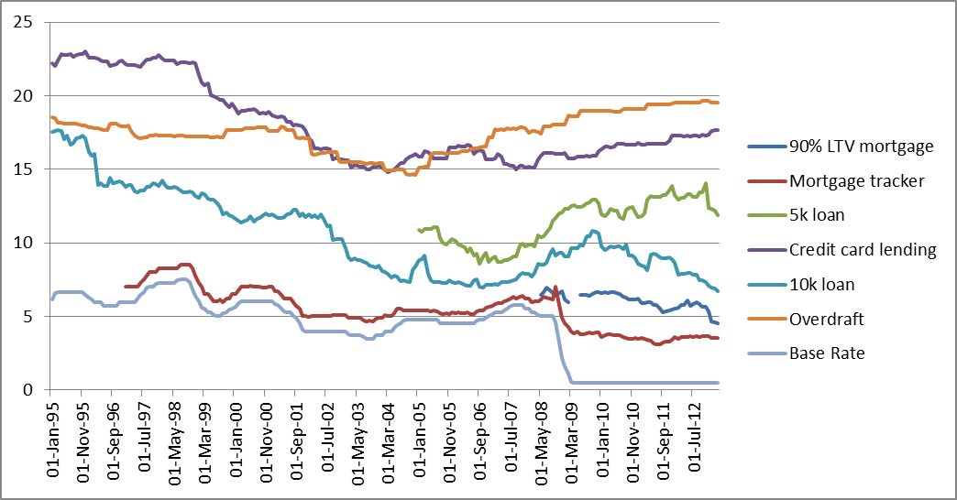
Effective households interest rates in the UK

Slide 146
Reading list on unconventional monetary policy
Frederic S. Mishkin, 1996. "The Channels of Monetary Transmission: Lessons for Monetary Policy," NBER Working Papers 5464.
Cecchetti, S. (2009) “Crisis and responses: the Federal Reserve in the early stages of the financial crisis” Journal of Economics Perspectives, vol 23(1), pp 51-75.
Benford, J., Berry, S., Nikolov, K., Young, C. and Robson, Mark (2009). “Quantitative easing” Bank of England Quarterly Bulletin, pp 90-100.
Meier, A. (2009). “Panacea, Curse, or Nonevent? Unconventional Monetary Policy in the United Kingdom.” IMF Working Paper 09/163.
Borio, C. and Disyatat, P. (2010) “Unconventional Monetary Policies: An Appraisal,” Manchester School, 78(s1), pp. 53-89.

